Slide 1

TYPE OF COMPETITION OF BUFALIN AS A LIGAND
CARLOTA BARCELÓ

Slide 2
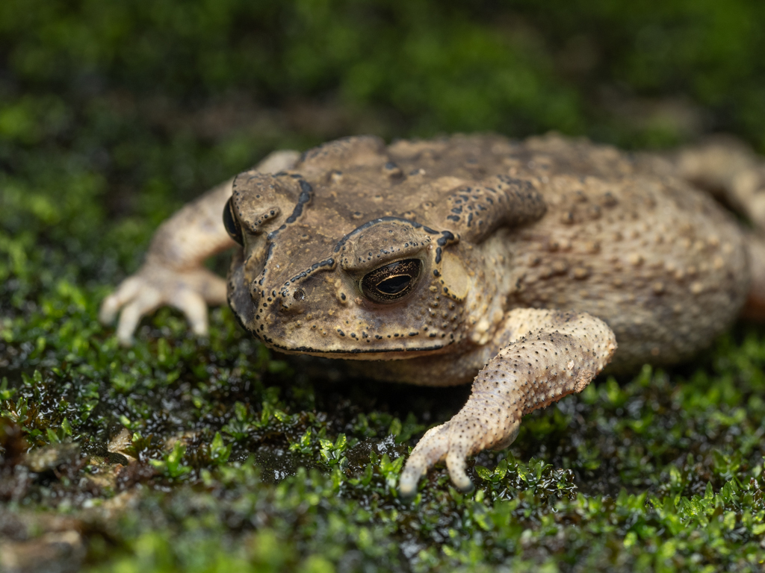
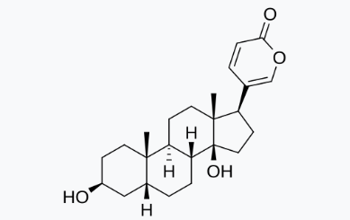
BUFALIN?

Slide 3
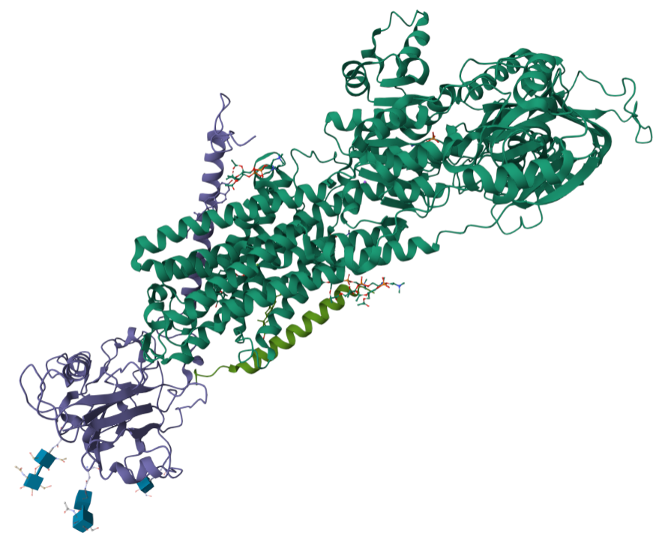
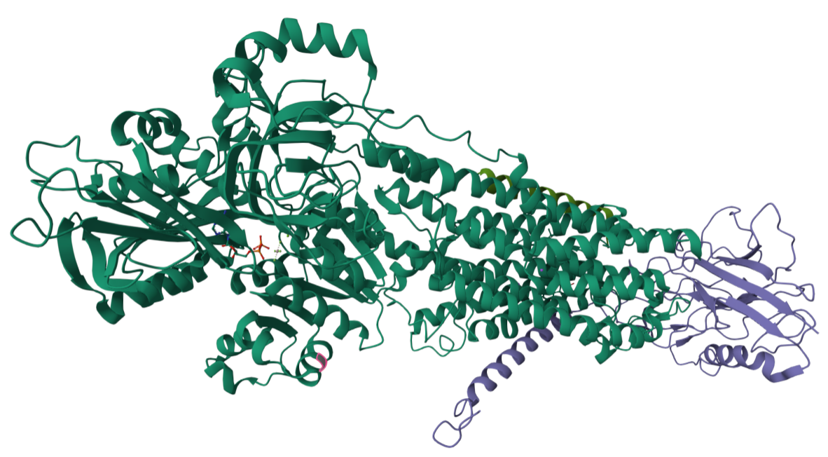
Na/K atpase pump
BUFALIN BOUND: 7DDL
ADP BOUND: 4HQJ
cholesterol
ADP
Na+
X-RAY DIFFRACTION

Slide 4
OBTAINING LIGANDS

Slide 5
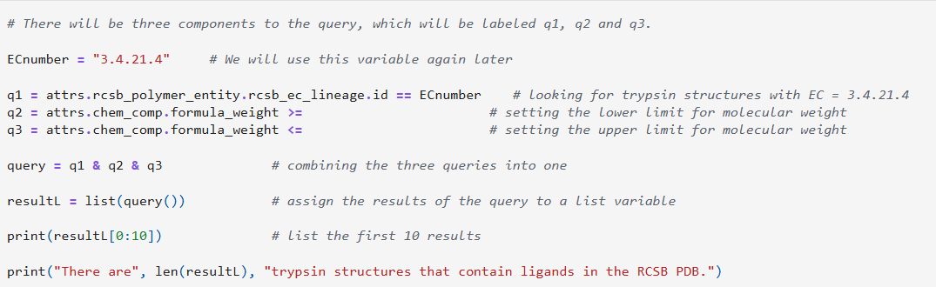
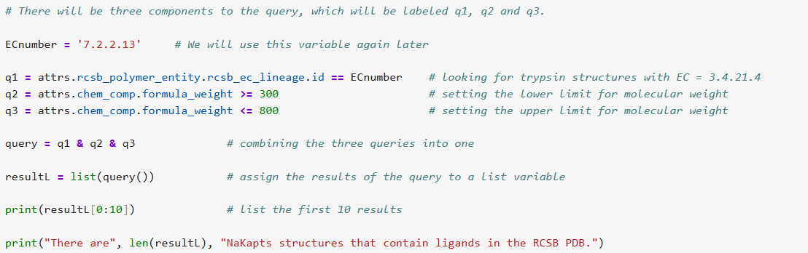
EC: 7.2.2.13
7 translocase
2 catalysing the translocation of inorganic cations and their chelates
2 Linked to the hydrolysis of a nucleoside triphosphate
13 Na⁺/K⁺-exchanging ATPase
Notes:
Why would we choose to have ligands with molecular weights between 300 and 800? We are interested in molecules that are large enough to bind to and fill up the active site of trypsin. Small molecules with molecular weights less than 300 are likely to be individual ions (K⁺ or Na⁺). Molecules with molecular weights greater than 800 will fill more than the active site of an enzyme.

Slide 6
DOCKING PREPARATION

Slide 7
Minor changes
!pdb2pqr --pdb-output=protein_structures/protein_h.pdb –pH=7.4 protein_structures/protein_2zq2.pdb protein_structures/protein_2zq2.pqr --whitespace
!python -m pdb2pqr --pdb-output=protein_structures/protein_4hqj.pdb --pH=7.4 protein_structures/protein_4hqj.pdb protein_structures/protein_4hqj.pqr --whitespace
Notes:
-m runs module as a script from the Shell within a notebook as pbd2pqr was correctly installed

Slide 8
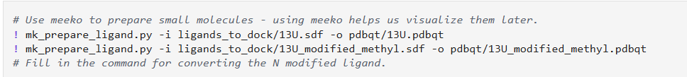

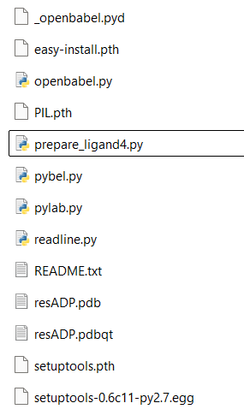
SDF TO PDB
obabel resADP.sdf -O resADP.pdb --gen3d
PDB TO PDBQT
python prepare_ligand4.py -l resADP.pdb -o resADP.pdbqt
Prepare ligands4.py is part of Autodock tools. Needs autodock tools and Molkit in the same folder to work

Slide 9
DOCKING

Slide 10
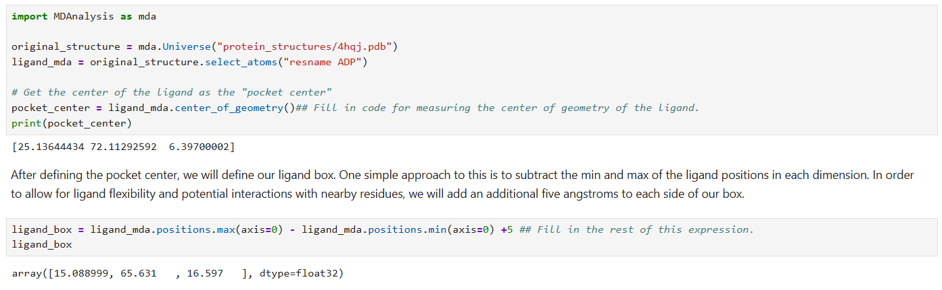
Important variables:

Slide 11
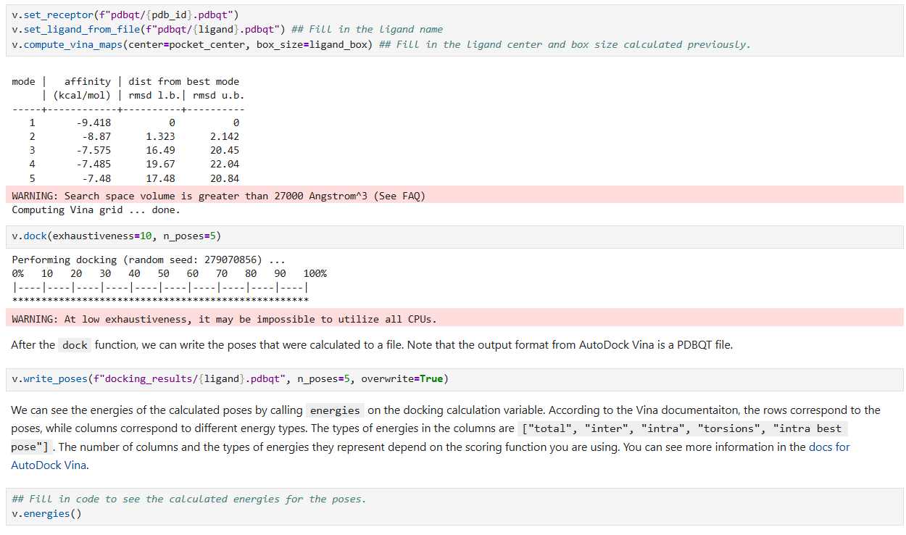

Slide 12
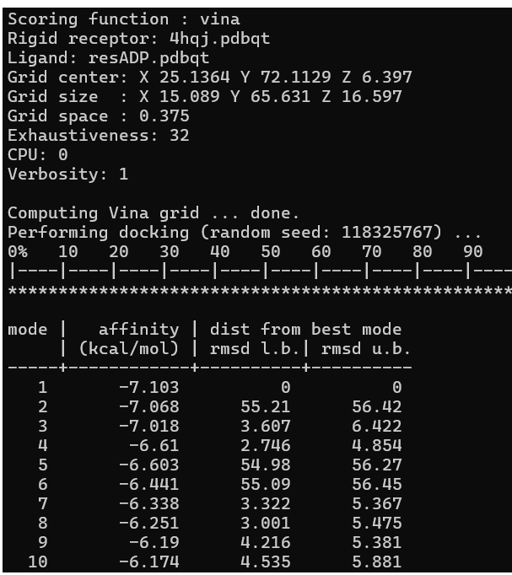
Vina from wsl:
vina --receptor pdbqt/4hqj.pdbqt --ligand pdbqt/resADP.pdbqt --center_x 25.13644434 --center_y 72.11292592 --center_z 6.39700002 --size_x 15.088999 --size_y 65.631 --size_z 16.597 --exhaustiveness 32 --num_modes 10 --out docking_results/resADP.pdbqt

Slide 13
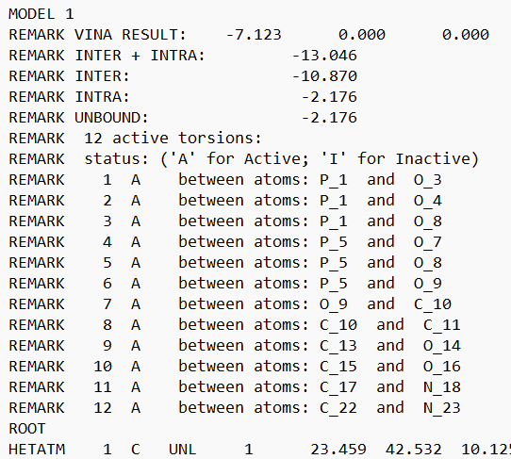
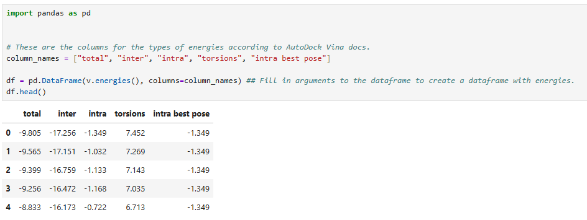
With no vina directly in the notebook, this isn’t posible:

Slide 14
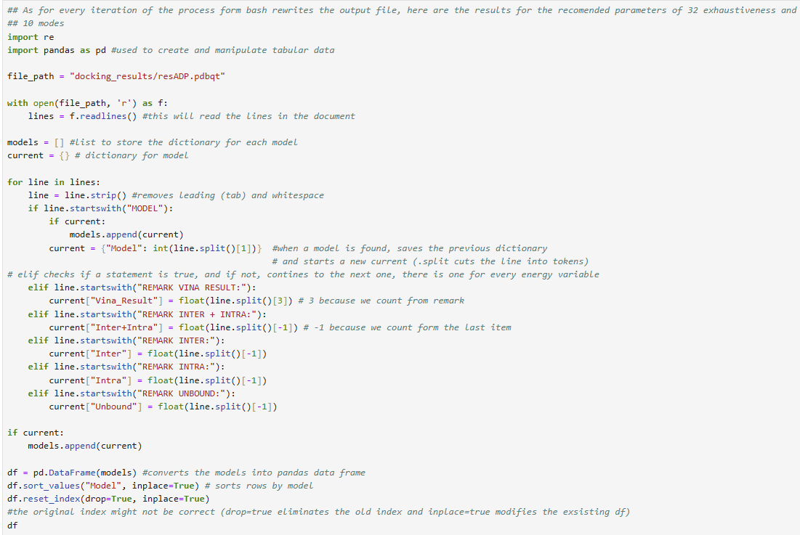

Slide 21
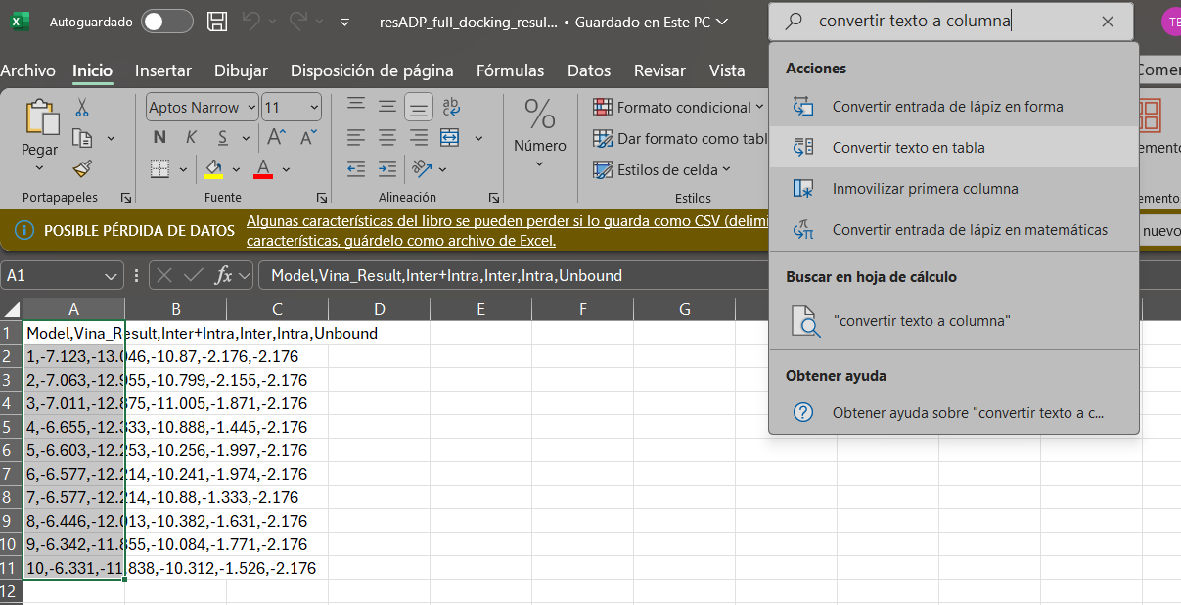
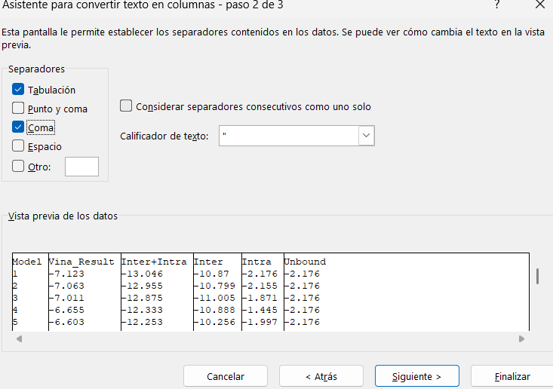
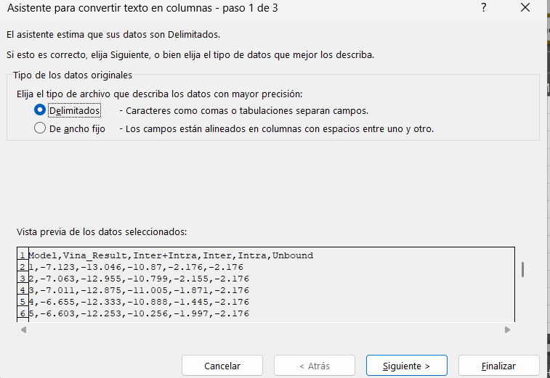
EXCEL:

Slide 22
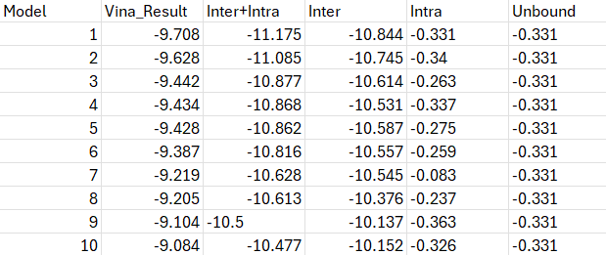
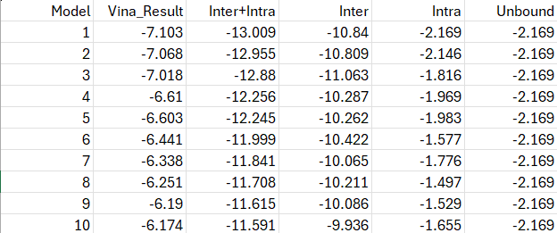
RESULTS:
bufalin energies (kcal/mol) ADP energies (kcal/mol)

Slide 23
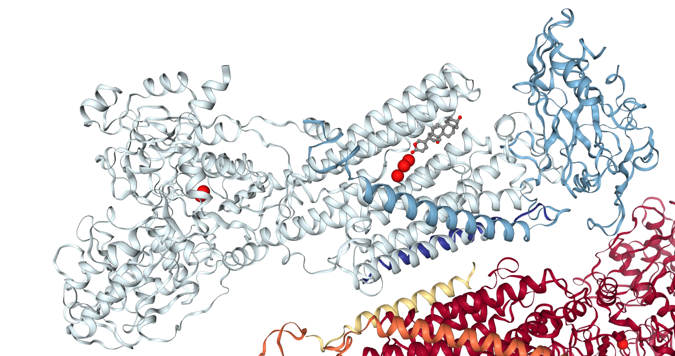
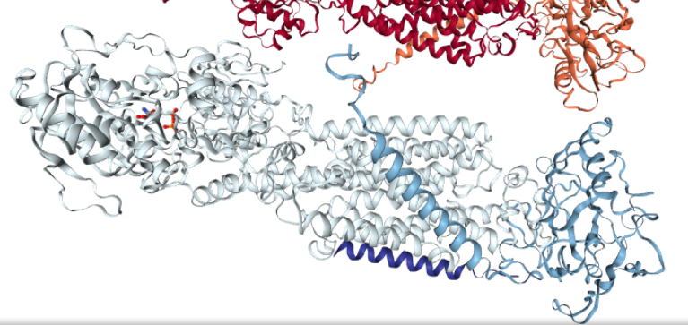
Bufalin bound to the Alpha helix bundle in the membrane domain
ADP bound to the cytosolic domain of the Na/k atpase pump

Slide 24
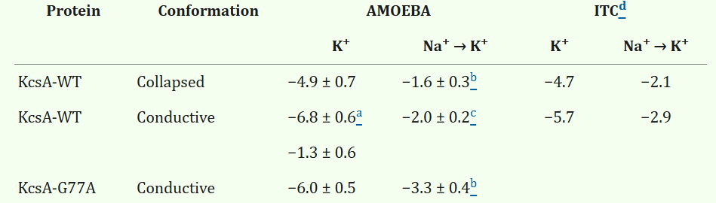
CONCLUSIONS:
Bufalin is not in a competitive environment with ADP, it’s an inhibitor for the translocase and allosterically, for ADP
Bufalin is in a competitive environment with K ions
https://pmc.ncbi.nlm.nih.gov/articles/PMC8246295/
Bufalin displaces K ions

Slide 25
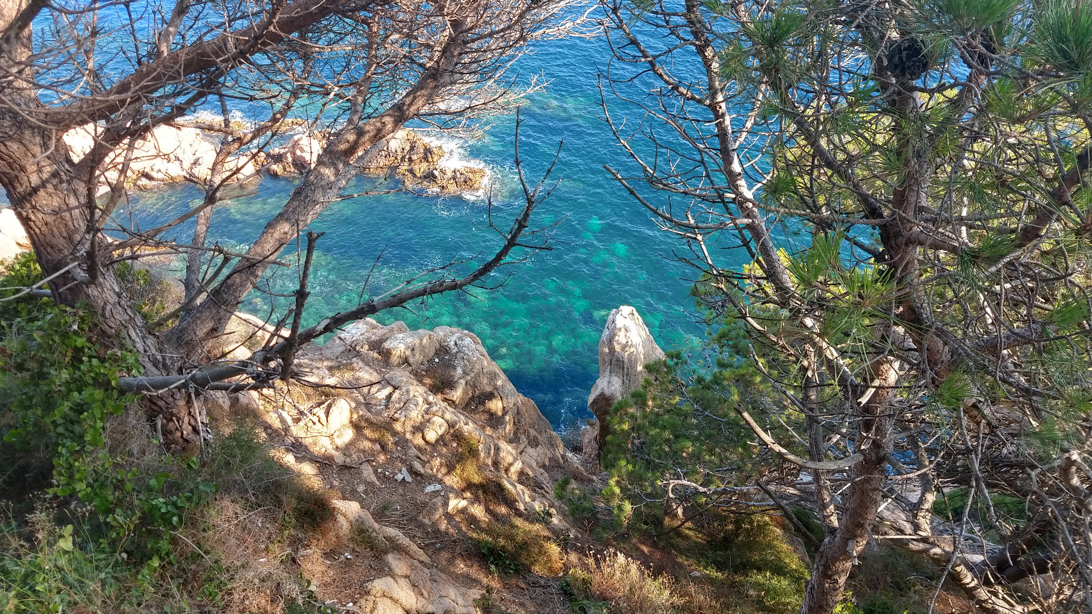
Thank you for listening and have a good summer

